Slide 1
Planning For High School and Beyond

Slide 2
Presenters
Marna Messer
Jeffco Director of Choice Options
Stephanie Sabga
College Counselor
Michelle Stone
Therapist
Jennifer Webb
Jeffco Gifted & Talented Resource Teacher

Slide 3
Courses and Classes

Slide 4
Overview of Programs & Course Options at the Secondary level
Jefferson County Public Schools
Jefferson County, Colorado

Slide 5
Programs: Gifted and Talented
GT Middle School Programs:
Creighton, Evergreen, Everitt, Ken Caryl, North Arvada,
West Jefferson
Contact School GT Resource Teacher
GT High School Programs:
Arvada HS and Wheat Ridge HS
Contact: Lisa.Lee@jeffco.k12.co.us

Slide 6
Programs: International Baccalaureate
IB Schools:
Standley Lake HS -- diploma program, certificate program, and MYP for all; contact Ben Thompson: bethomps@jeffco.k12.co.us
Lakewood HS -- diploma program only; contact Joellen Kramer: joellen.kramer@jeffco.k12.co.us
Alameda Int. HS -- diploma program, certificate program, career program, and MYP for all; contact Merinda Sautel: merinda.sautel@jeffco.k12.co.us
DRHS -- diploma program, certificate program, introducing MYP in grade 9 & 10 Honors; contact Holly Davis: holly.davis@jeffco.k12.co.us

Slide 7
Other Course Options
General education, Honors, and Electives:
Refer to school’s course guide; speak with counselor or subject area teacher.
Advanced Placement (AP):
Students test at end of year for possible college credit; credit determined by individual college or university
Concurrent enrollment and Dual enrollment courses:
Students can earn high school and college credit for successful course completion; credit may be guaranteed or may be determined by university
Career-Technical Education (CTE):
Neighborhood schools and Warren Tech, Warren Tech North, and Warren Tech South

Slide 8
Option Programs

Slide 9
Student Pathways
Marna Messer
Director Choice Programming
Marna.Messer@jeffco.k12.co.us

Slide 10
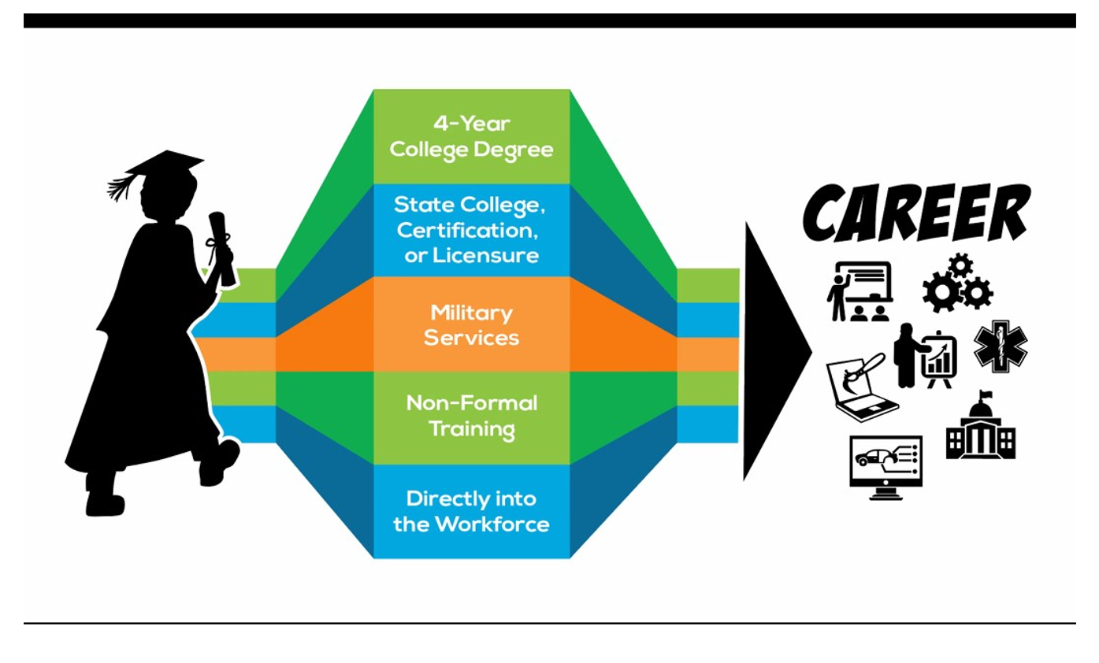

Slide 11
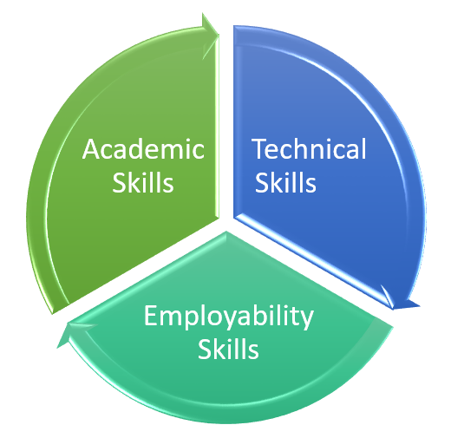
Career and College Readiness
“Career and technical education (CTE) is an educational strategy for providing young people with the academic, technical, and employability skills and knowledge to pursue postsecondary training or higher education and enter a career field prepared for ongoing learning”
~Partnership for 21st Century Skills
Notes:
The reason Career Pathways are critical for our students is that they prepare students for both Career and College. Jeffco Career Pathways are designed to ensure every student has the skills to be successful in a future career whether it be after high school or after college. This means we focus on three key areas: academic, technical, and employability skills. A good career pathway in high school and postsecondary connects these three areas effectively. Students are learning how to apply academic skills while learning technical skills. Students are developing employability skills through authentic learning experiences.

Slide 12
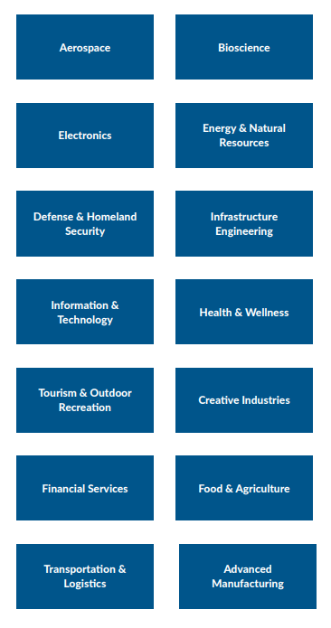
Top Areas for Jobs in Colorado
Employment Resources:
Colorado Workforce and Development
My Colorado Journey
2021 Talent Pipeline Report
Bureau of Labor Statistics

Slide 13
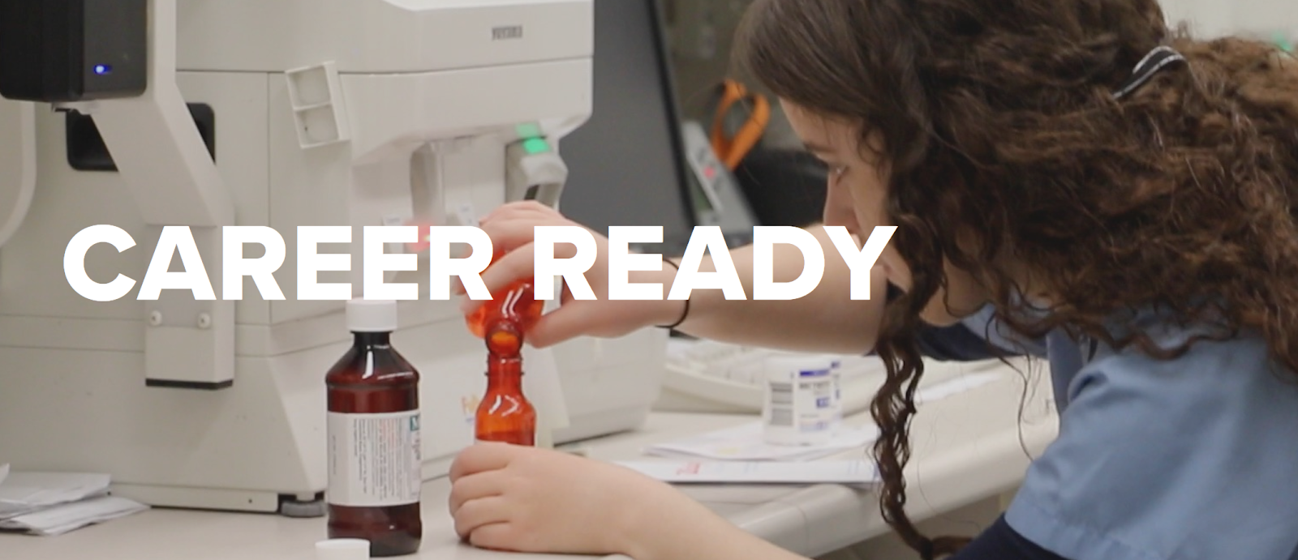
Future Ready Students

Slide 14
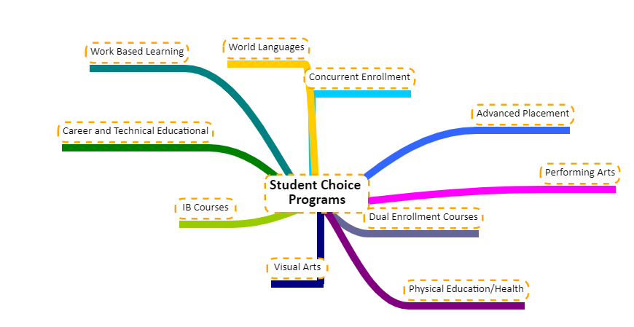
Student Centered Options

Slide 15
Career Pathways
Every High School in Jeffco has Career Pathways for students to explore.
In addition, Warren Tech has 3 campuses with high demand pathways for students
Notes:
2 min
Connecting to roles and exploring things like STEM and other learning opportunities in elementary, broadening and deepening with a combined exploratory in middle, developing clear pathway options in high schools

Slide 16
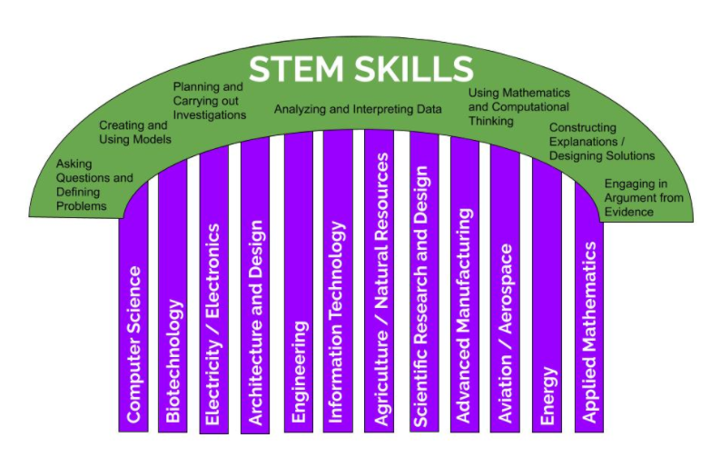
Focus on STEM

Slide 18
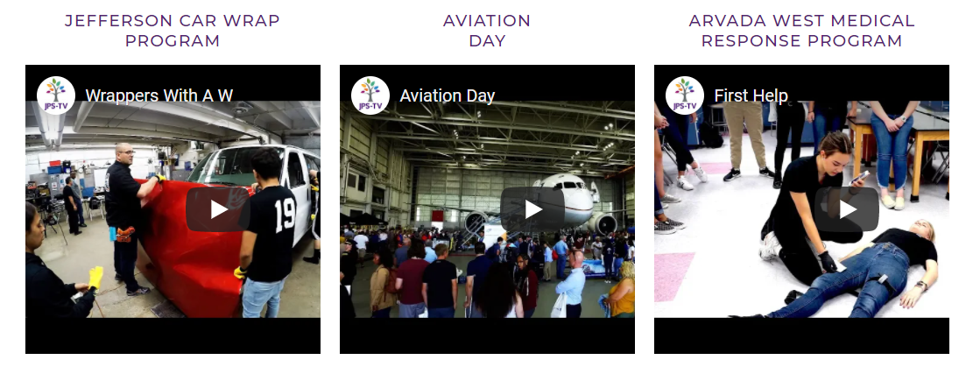
Jeffco Career Links

Slide 19
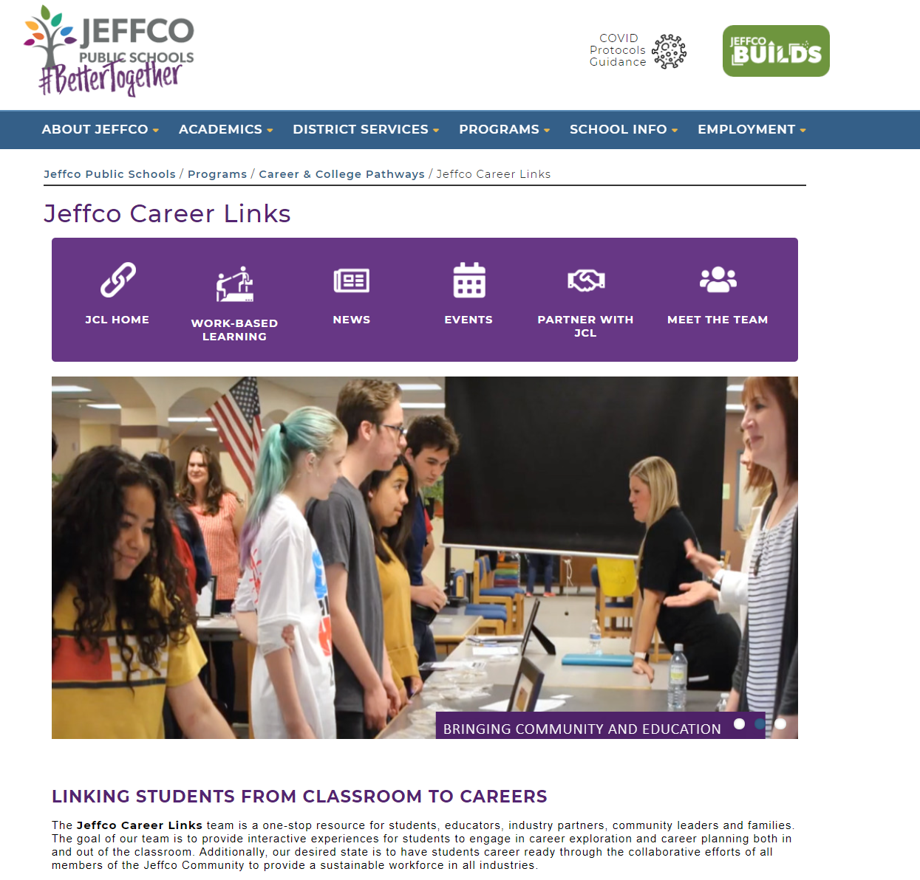
Career Expo for 10th graders
Industry Interviews for Juniors and Seniors
Capstone Mentors/Field Experts
Internship programs
CareerWise Apprenticeships
Industry Sponsored Projects
Notes:
In considering career pathways and how they support student learning, work based learning is a critical component. Our 3 person Jeffco Career Links team supports our 169 CTE programs and all other student wbl opportunities such as industry interviews, resume support, the Career Expo, Capstone Field Experts, and internships/apprenticeships. They also provide an incredible service by connecting and networking with industry to build strong partnerships for Jeffco students.

Slide 20
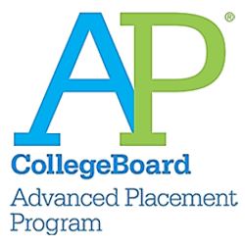
Jeffco offers college credit courses in most high schools.
These courses provide opportunities for students to learn and practice for the rigors of postsecondary.
Student choices should align with their Individual Career and Academic Plan
Concurrent Enrollment and Dual Enrollment

Slide 21
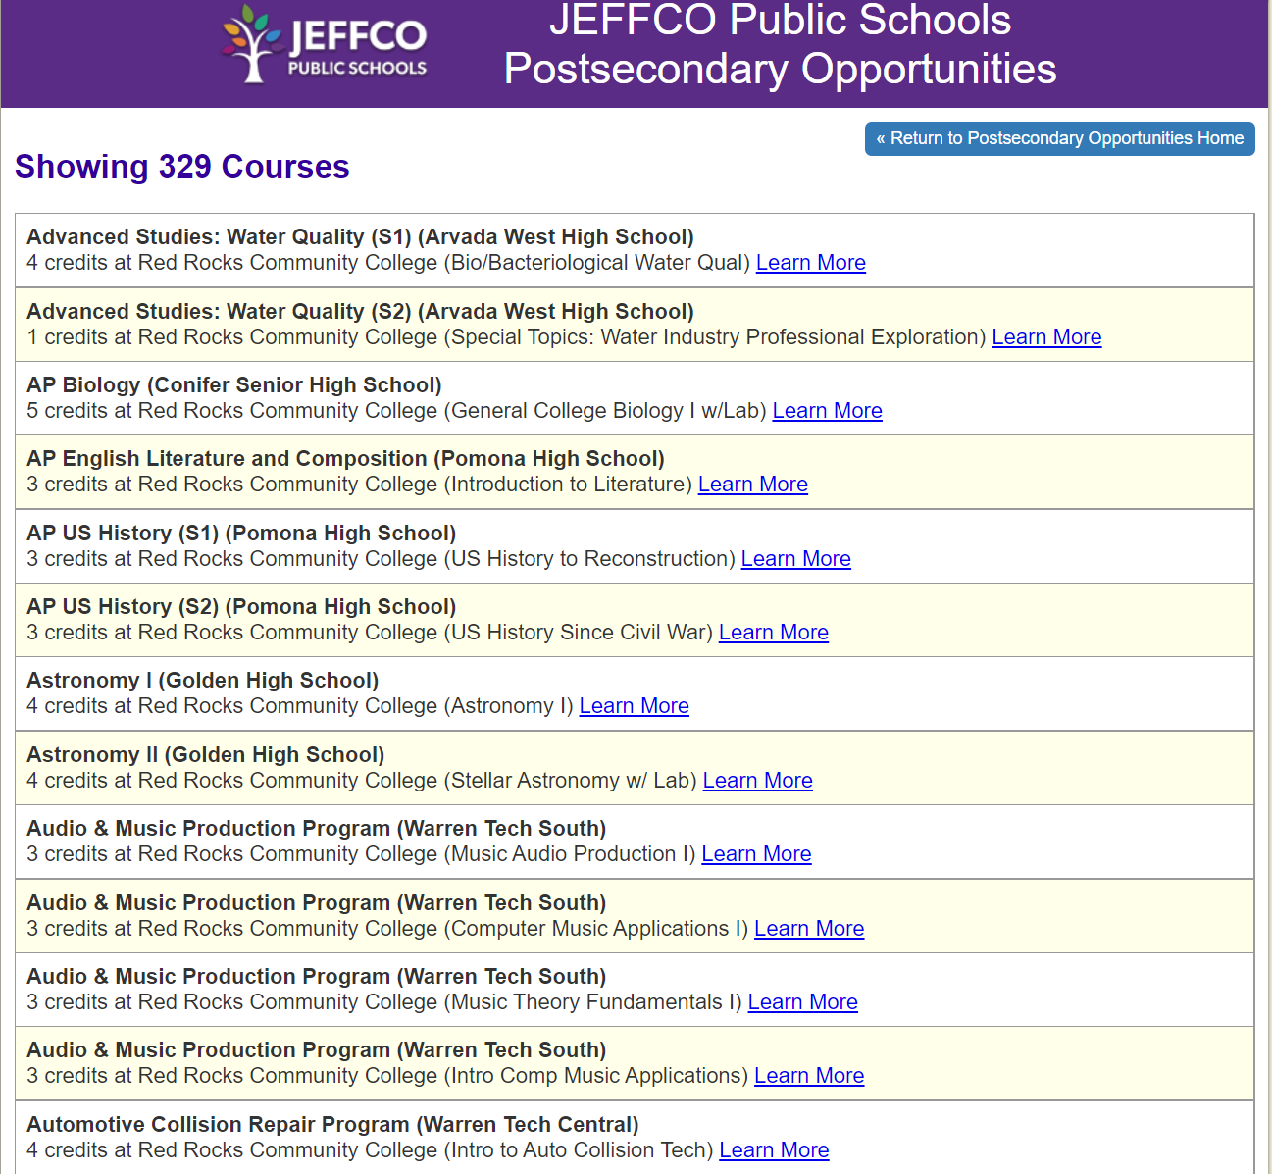
Jeffco Postsecondary Opportunities
Overview of Postsecondary Opportunities
Student/Parent Handbook for Postsecondary options
Searchable Database for Postsecondary Opportunities in Jeffco
Notes:
If families and community would like to learn more about our postsecondary opportunities they can visit the career and college pathways on our jeffco website. We are required by law to post these opportunities on our public website. There they will find a link to a searchable database that includes all postsecondary courses located at our neighborhood schools, option schools, charter schools, and Warren Tech. They can also search by pathway of interest.

Slide 22
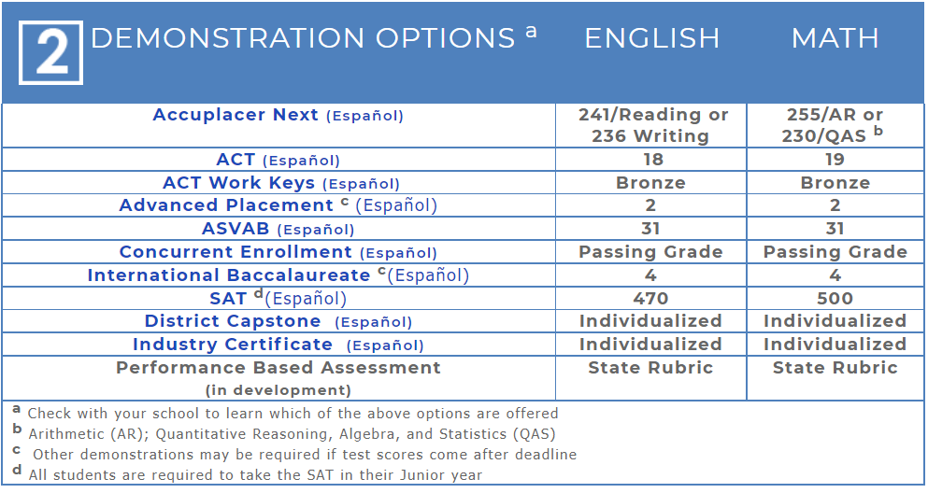
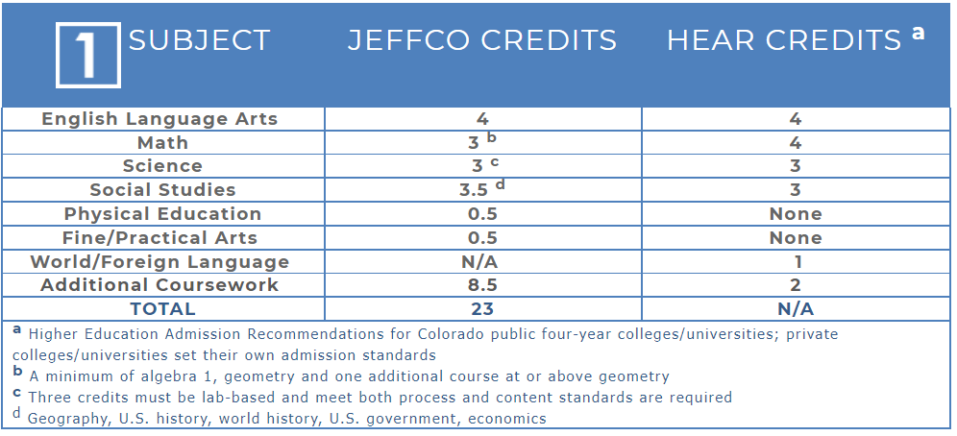
Graduation Requirements

Slide 23
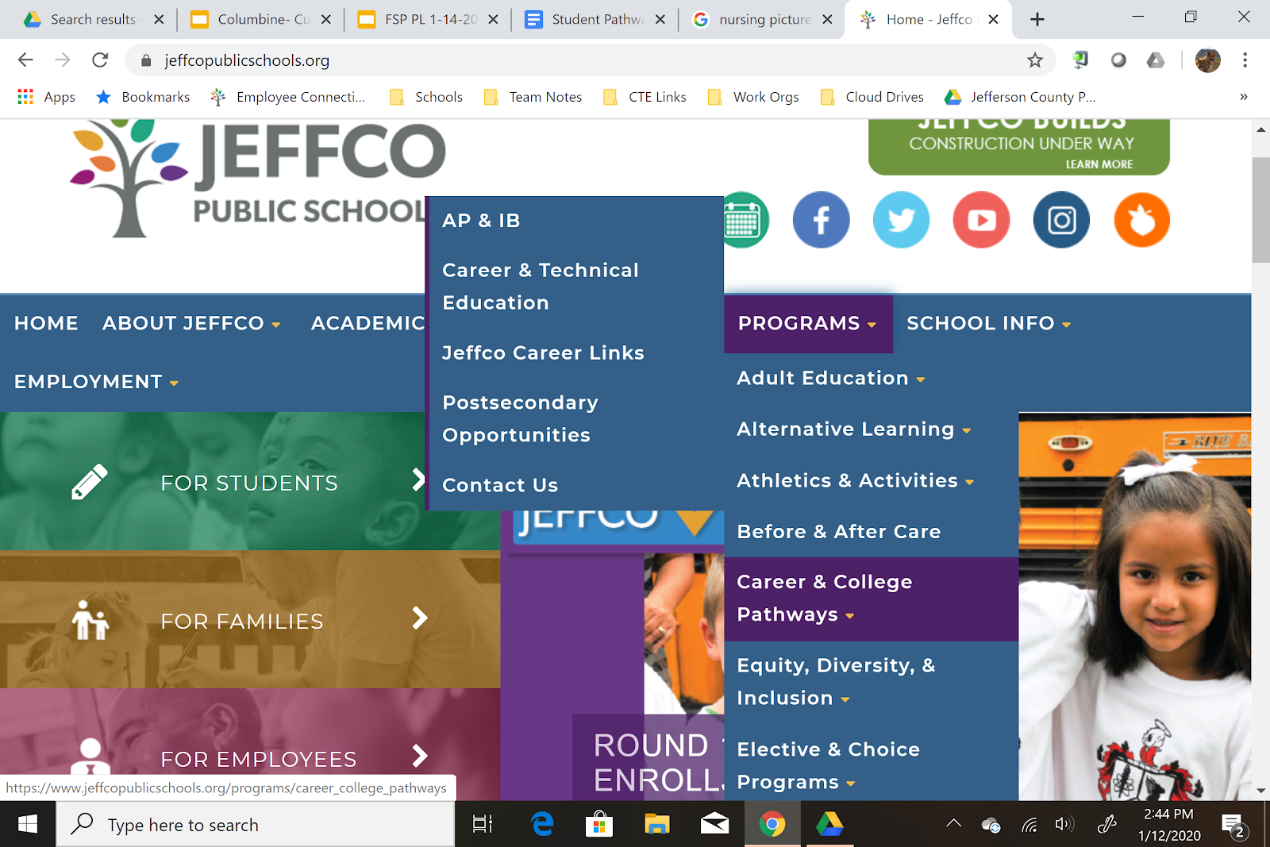
Notes:
Follow up with student ICAP process
Contact your school counselor for more information
Support students exploring multiple career learning opportunities
Please email me with any additional quesitons

Slide 24
College Counseling

Slide 25
SO MANY COLLEGES!
2,830 4-year colleges
1,530 2-year colleges
EVERYONE
can go to college

Slide 26
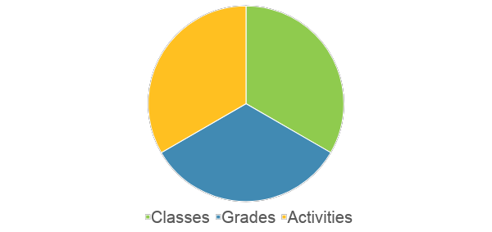
PREPARATION IN HIGH SCHOOL

Slide 27
CLASSES AND GRADES
Consider curriculum (AP, IB, other)
Consider honors and weighted classes
Understand class sequence
Review graduation requirements (as well as college admission requirements)
Goal - earn A or A+ in the hardest classes you can take
Review your transcript each term and set goals to improve

Slide 28
EXTRACURRICULAR ACTIVITIES
Join clubs at school or outside of school
Try new things but stick with activities to demonstrate commitment
Volunteering is critical
Consider joining a team even if you are not a strong athlete
Jobs are excellent
Find additional opportunities like research, internships, classes outside of school

Slide 29
EXTRACURRICULAR GOALS
National
State
Leadership
What you want to Achieve
Captain
Depth
Community
Selected or elected
School
Volunteer

Slide 30
WHAT MAKES COLLEGE FIT?
Academic
major or program
class size
difficulty
Social
sports/activities
type of students
Greek system
campus life
Financial
cost of attendance
types of aid offered

Slide 31
ADDITIONAL FACTORS
Academic
major or program
class size
difficulty
Academic support
Recruited athletics
Religious affiliation
Research
Social
sports/activities
type of students
Greek system
campus life
Financial
cost of attendance
types of aid offered

Slide 32
FINANCIAL
Understand aid – merit and need-based
Research the Cost of Attendance
Use the Net Price Calculator
Have conversations about the cost of college
Be prepared to fill out financial documents
Consider the financial fit before applying

Slide 33
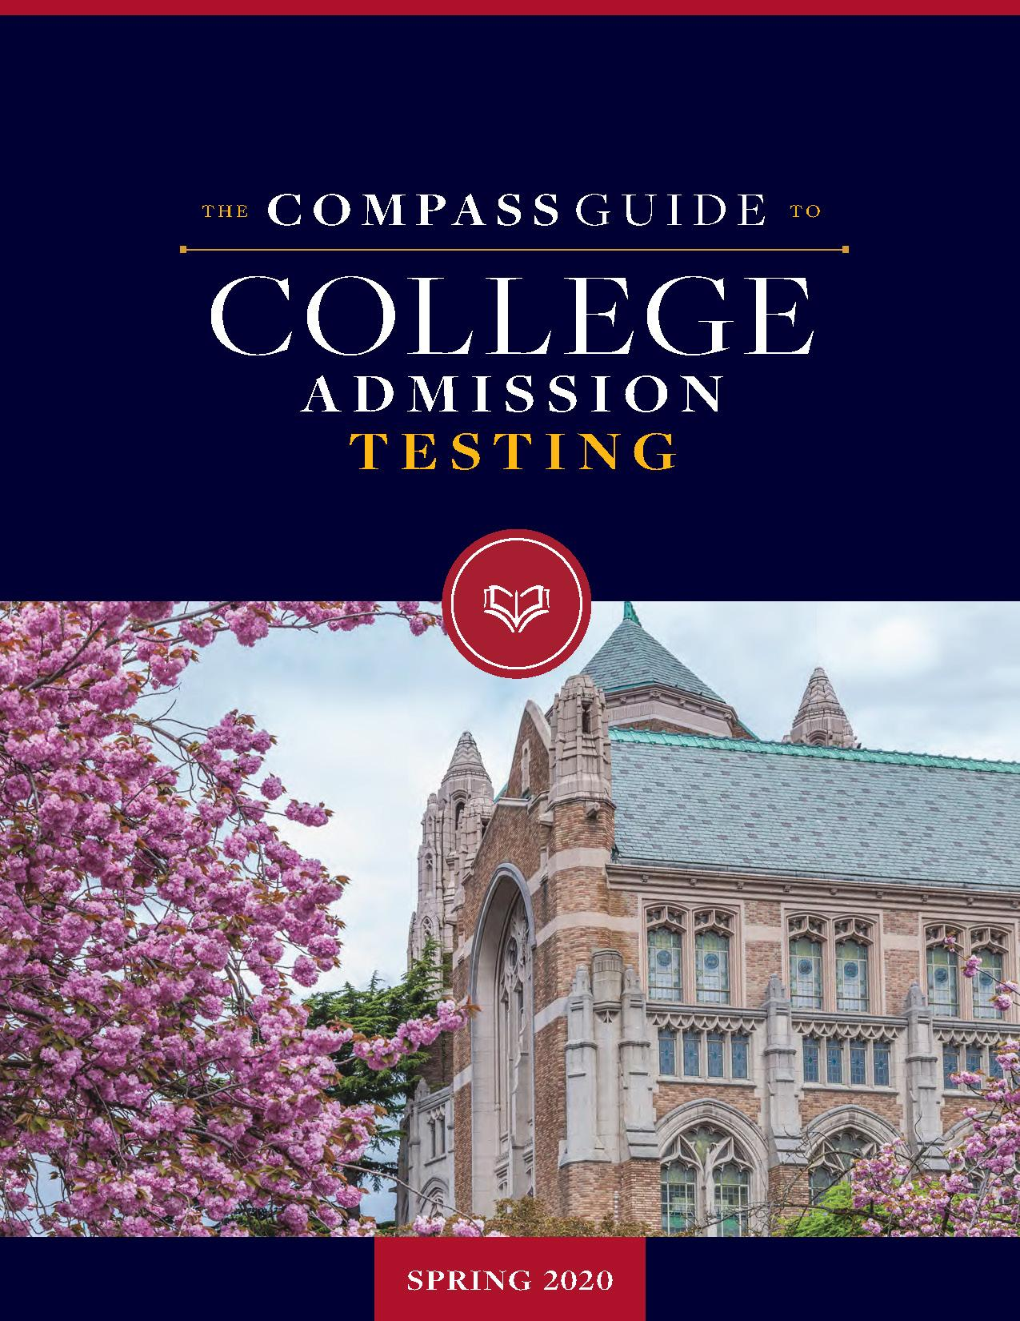
TEST-OPTIONAL
COLLEGE BOARD/ACT UPDATES
◦ The test-optional movement is not new!
◦ By Sept. 2020 over 2/3 of 4-year schools waived their test score requirement.
◦ Same trend for this year.
◦ Term test-blind was introduced.
◦ Fairtest.org: https://fairtest.org/university/optional
◦ SAT Subject Tests were discontinued effective Jan. 2021.
◦ Optional Essay section of the SAT was also discontinued.
◦ Testing opportunities to take the SAT & ACT are beginning to open up in some places.
◦ Test Prep: free resources, high school-sponsored prep classes, private tutoring companies.

Slide 34
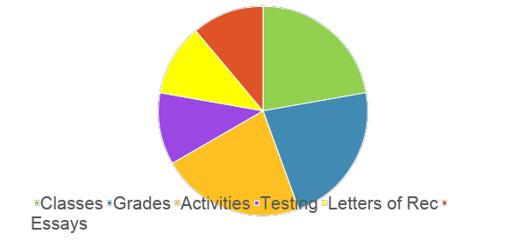
COLLEGE APPLICATION

Slide 35
THANK YOU!
Stephanie Sabga
www.sabgacollegeconsulting.com
303-717-0854
stephanie@sabgacollegeconsulting.com

Slide 36
Mental Health
Considerations

Slide 37
Thank you for attending!
Visit the JAGC website for additional resources:
https://www.jeffcogifted.org/planning-for-high-school--beyond-webinar-1-13-21.html
Jefferson Association for Gifted Children (JAGC) is a nonprofit organization of families and educators who advocate for advanced learners in Jefferson County, Colorado.
Website: JeffcoGifted.org
Fecebook: facebook.com/JeffcoGifted/
Email: Info@JeffcoGifted.org

Slide 38
What Does JAGC Do?
What Can JAGC Do For Me?
Our Focus
Ensure consistency in programming
Offer education and outreach to schools
Educate the Board of Education and district leadership on advanced learners
Understand and support twice exceptional (2e) students
Support Jeffco in the Advanced Learning Plan (ALP) process
Communicate opportunities and resources to families
Provide social-emotional support for families and schools
Recognizes GT excellence with our annual GT Champion Awards
Our Successes
Advocated for high school credit for some middle school courses
Secured additional GT Center seats across the district
Ensured the district accommodated GT Center 6th graders moving to middle school
Worked with the Colorado Department of Education to implement GT needs in the Every Student Succeeds Act
Were instrumental in establishing Jeffco's (and Colorado's) first GT Center high school program at Wheat Ridge High School
Continue to work with Jeffco to bring uniform programming to all students with ALPs
Website: JeffcoGifted.org
Facebook: JeffcoGifted
Email: info@jeffcogifted.org

